Slide 1
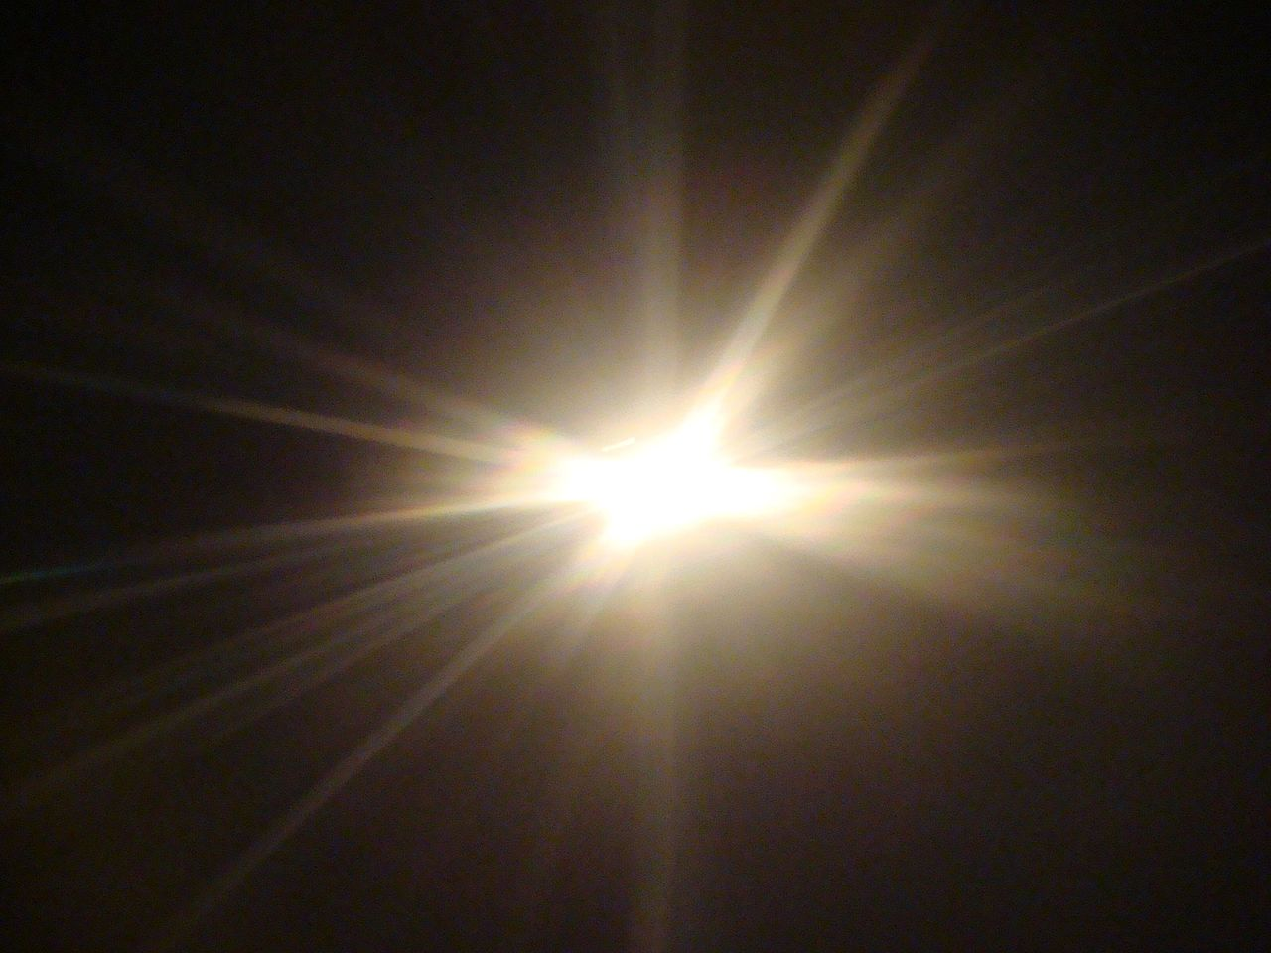
Darkness—Light
This Photo by Unknown Author is licensed under CC BY-NC-ND
This Photo by Unknown Author is licensed under CC BY-SA

Slide 2
Beginning—end
This Photo by Unknown Author is licensed under CC BY-SA
This Photo by Unknown Author is licensed under CC BY-NC

Slide 3
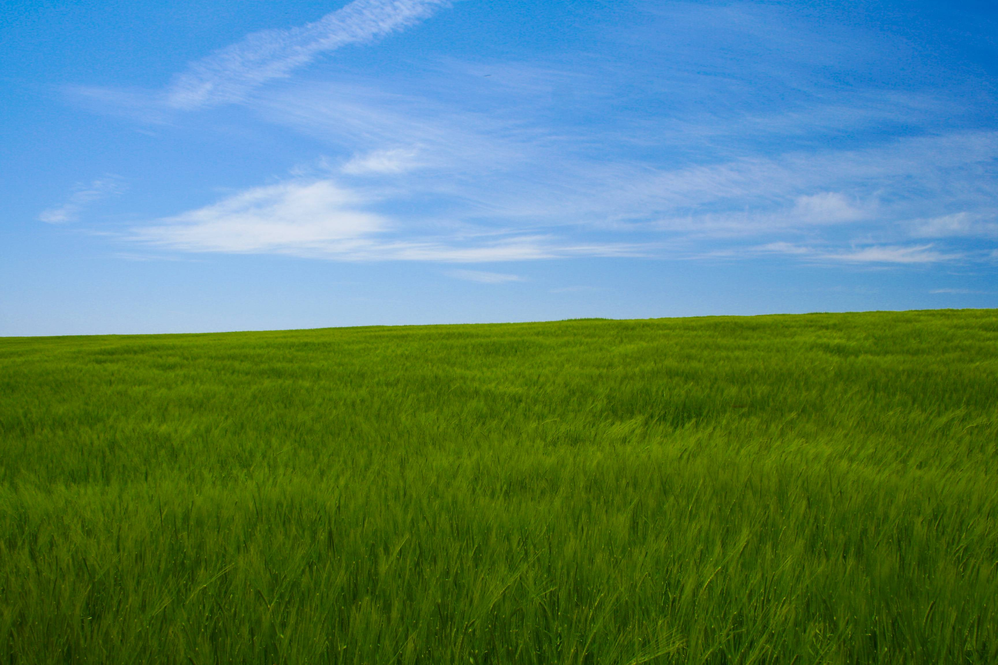
Sky
Earth
This Photo by Unknown Author is licensed under CC BY-SA

Slide 4
Empty—full
This Photo by Unknown Author is licensed under CC BY
This Photo by Unknown Author is licensed under CC BY

Slide 5
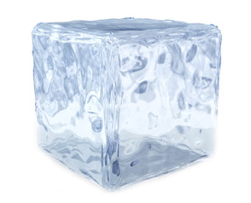
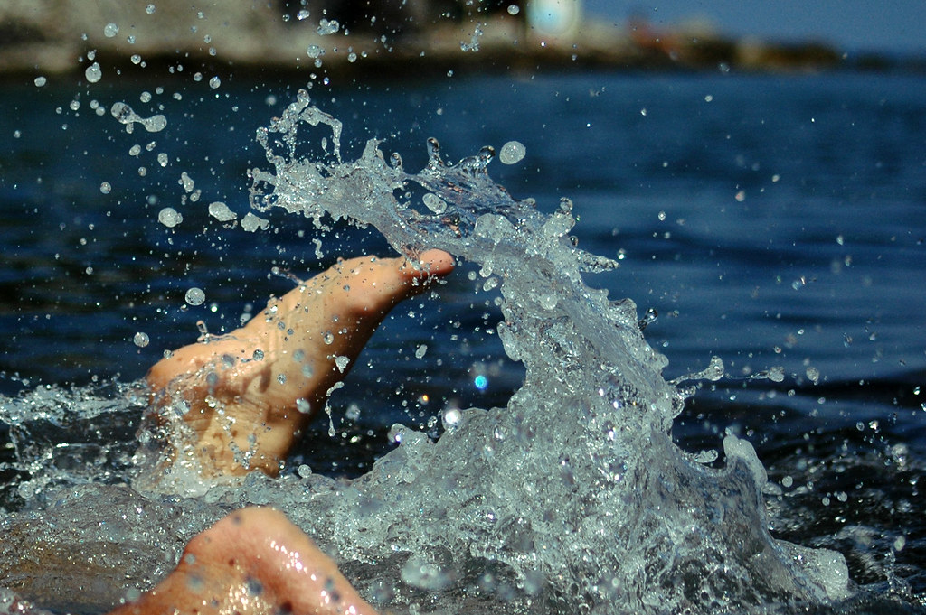
Form—no form
This Photo by Unknown Author is licensed under CC BY-NC-ND
This Photo by Unknown Author is licensed under CC BY-NC-ND

Slide 6
Good—Bad
This Photo by Unknown Author is licensed under CC BY-SA
This Photo by Unknown Author is licensed under CC BY-SA-NC

Slide 7
Day—Night

Slide 8
Evening Morning
This Photo by Unknown Author is licensed under CC BY-SA-NC

